Slide 1


Slide 2



Ratios, Proportions and Variations Quiz
https://qrgo.page.
link/WL1w5

Slide 3
MIXTURES AND ALLIGATIONS

Slide 4

Concepts:
Alligation: It is the rule that enables us to find the ratio in which two or more ingredients at the given price must be mixed to produce a mixture of desired price.
Mean Price: The cost of a unit quantity of the mixture is called the mean price.
Rule of Alligation: If two ingredients are mixed, then

Slide 5
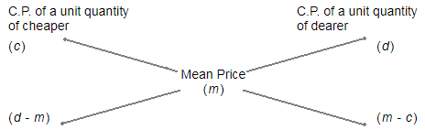
Concepts:
(Cheaper quantity) : (Dearer quantity) = (d - m) : (m - c).
Suppose a container contains x of liquid from which y units are taken out and replaced by water.
After n operations, the quantity of pure liquid = [x(1-(y/x))^n] units

Slide 6
Question 01:
In what ratio must rice at Rs 9.30 per kg be mixed with rice at
Rs 10.80 per kg so that the mixture be worth Rs 10 per kg?
A. 6:5
B. 8:7
C. 3:7
D. 6:1
Answer: B

Slide 7
Explanation:
C.P of 1 Kg C.P of 1 Kg
rice of 1st rice of 2nd
kind (930p) kind (1080p)
\ / Mean Price
(1000p)
/ \
(1080 – 1000) : (1000 - 930)
80 70
Thus, required ratio = 80 : 70 = 8 : 7

Slide 8
Question 02:
In what ratio must wheat at Rs. 3.20 per kg be mixed with
wheat at Rs. 2.90 per kg so that the mixture be worth Rs. 3.08 per kg?
A. 3 : 4
B. 2 : 3
C. 3 : 2
D. 4 : 3
Answer: C

Slide 9
Explanation:
C.P of a unit quantity of 1st kind = Rs. 3.20 C.P of a unit quantity of 2nd kind = Rs. 2.90 Mean price = Rs.3.08
C.P of unit quantity C.P of unit quantity
of 1st kind of 2nd kind
(Rs. 3.20) (Rs. 2.90)
\ / Mean Price
(Rs.3.08)
/ \
(3.08 – 2.90) : (3.20 – 3.08)
0.18 0.12
Required ratio = 0.18 : 0.12 = 3 : 2

Slide 10
Question 04:
In what proportion must rice at Rs. 3.10 per kg be mixed with
rice at Rs. 3.60 per kg so that the mixture be worth Rs. 3.25 per kg?
A. 3 : 7
B. 5 : 3
C. 3 : 5
D. 7 : 3
Answer: D

Slide 11
Explanation:
C.P of a unit quantity of 1st kind = 310p (in paise) C.P of a unit quantity of 2nd kind = 360p Mean price = 325p
C.P of unit quantity C.P of unit quantity
of 1st kind of 2nd kind
(310p) (360p)
\ / Mean Price
(325p)
/ \
(360 – 325) : (325 – 310)
35 15
Required ratio = 35 : 15 = 7 : 3 They must be mixed in the ratio 7 : 3

Slide 12
Question 05:
In what ratio must tea at Rs. 62 per kg be mixed with tea at
Rs. 72 per kg so that the mixture must be worth Rs. 64.50 per kg?
A. 1 : 3
B. 2 : 3
C. 3 : 1
D. 3 : 2
Answer: C

Slide 13
Explanation:
C.P of a unit quantity of 1st kind = Rs. 62 C.P of a unit quantity of 2nd kind = Rs. 72 Mean price = Rs. 64.50
C.P of unit quantity C.P of unit quantity
of 1st kind of 2nd kind
(Rs. 62) (Rs. 72)
\ / Mean Price
(Rs. 64.50)
/ \
(72 – 64.50) : (64.50 – 62)
7.50 2.50
Required ratio = 7.50 : 2.50 = 3 : 1

Slide 14
Question 06:
The ratio, in which tea costing Rs. 192 per kg is to be mixed
with tea costing Rs. 150 per kg so that the mixed tea when sold for Rs. 194.40 per kg, gives a profit of 20%.
A. 1:2
B. 2:5
C. 3:5
D. 3:7
Answer: B

Slide 15
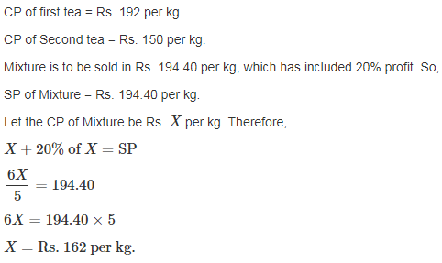
Explanation:

Slide 16
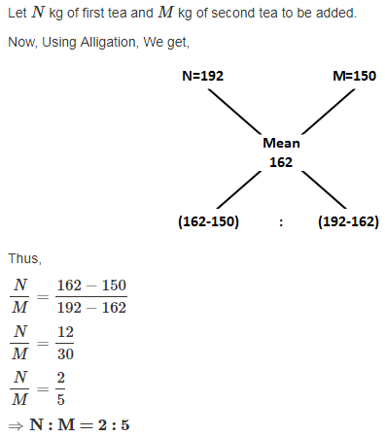
Explanation:

Slide 17
Question 08:
If Ram's weight is increased by 10% and total weight of Ram and Shyam become 82.8 kg, with an increases of 15%, Weights of two friends Ram and Shyam are in the ratio 4:5. by what percent did the weight of Shyam has to be increased?
A. 17%
B. 19%
C. 23%
D. 29%
Answer: B

Slide 18
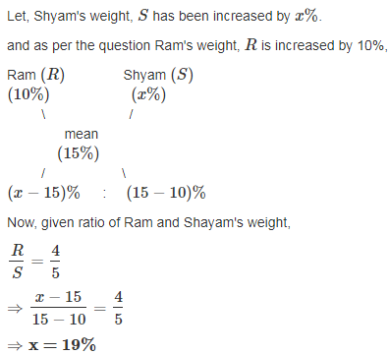
Explanation:

Slide 19
Question 09:
In a 729 litres mixture of milk and water, the ratio of milk to water is 7:2.To get a new mixture containing milk and water in the ratio 7:3, the amount of water to be added is_________.
A. 51 litres
B. 61 litres
C. 71 litres
D. 81 litres
Answer: D

Slide 20
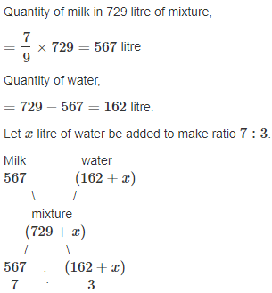
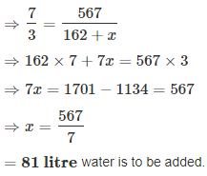
Explanation:

Slide 21
Explanation:

Slide 22
Question 10:
In a mixture 60 litres, the ratio of milk and water 2 : 1. If this ratio is to be 1 : 2, then the quantity of water to be further added is:
[A]. 20 litres
[B]. 30 litres
[C]. 40 litres
[D]. 60 litres
Answer: D

Slide 23
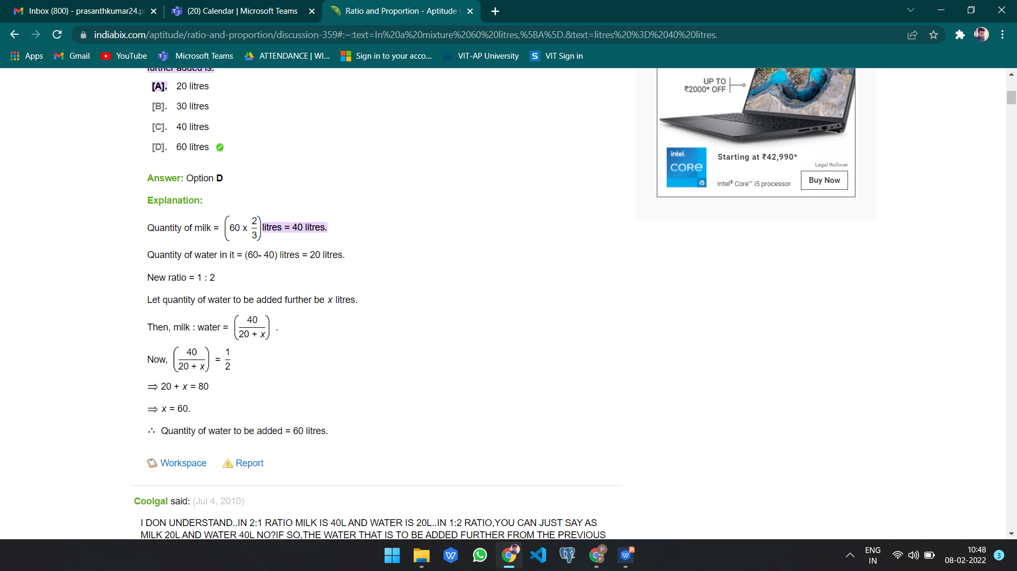
Explanation:
Quantity of milk =(60 x2/3) litres = 40 litres.
Quantity of water in it = (60- 40) litres = 20 litres.
New ratio = 1 : 2
Let quantity of water to be added further be x litres.
Then, milk : water =40/20 + x
.
Now, 40/20 + x=1/2
20 + x = 80
x = 60.
Quantity of water to be added = 60 litres.

Slide 24
Question 11:
The milk and water in two vessels A and B are in the ratio 4:3 and 2:3 respectively. In what ratio the liquids in both the vessels be mixed to obtain a new mixture in vessel c consisting half milk and half water?
A. 8 : 3
B. 7 : 5
C. 4 : 3
D. 2 : 3
Answer: B

Slide 25
Explanation:
Milk in 1 litre mixture of A = 4/7 litre.
Milk in 1 litre mixture of B = 2/5 litre.
Milk in 1 litre mixture of C = 1/2 litre.
By rule of alligation we have required ratio X:Y
X : Y
4/7 2/5
\ /
(Mean ratio) (1/2)
/ \
(1/2 – 2/5) : (4/7 – 1/2)
1/10 1/1 4
So Required ratio = X : Y = 1/10 : 1/14 = 7:5

Slide 26
Question 12:
Two vessels A and B contain spirit and water mixed in the ratio 5:2 and 7:6 respectively. Find the ratio in which these mixture be mixed to obtain a new mixture in vessel c containing spirit and water in the ratio 8:5?
A. 1 : 7
B. 2 : 9
C. 7 : 9
D. 3 : 8
Answer: C

Slide 27
Explanation:
Spirit in 1 litre mix of A = 5/7 litre.
Spirit in 1 litre mix of B = 7/13 litre.
Spirit in 1 litre mix of C = 8/13 litre.
By rule of alligation we have required ratio X:Y
X : Y
5/7 7/13
\ /
(8/13)
/ \
(1/13) : (9/91) => 7:9 Therefore required ratio = 1/13 : 9/91
=7: 9

Slide 28
Question 13:
How many kilograms of sugar costing Rs. 9 per kg must be mixed with 27 kg of sugar costing Rs.7 per kg so that there may be gain of 10% by selling the mixture at Rs. 9.24 per kg?
A. 60 kg
B. 63 kg
C. 50 kg
D. 77 kg
Answer: B

Slide 29
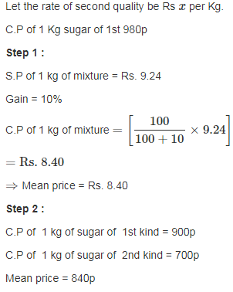
Explanation:

Slide 30
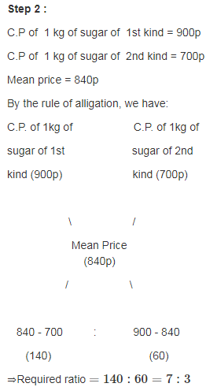
Explanation:

Slide 31
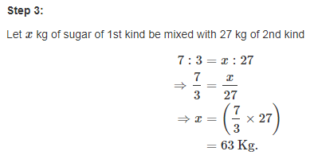
Explanation:

Slide 32
Question 14:
One quantity of wheat at Rs 9.30 per kg is mixed with another quality at a certain rate in the ratio 8:7. If the mixture so formed be worth Rs 10 per kg, what is the rate per kg of the second quality of wheat?
A. Rs. 12.47
B. Rs. 10.80
C. Rs. 15.17
D. Rs. 47.66
Answer: B

Slide 33
Explanation:
]By rule of alligation we have required ratio 8 : 7
9.30 x
\ /
(Mean Price) (10)
/ \
x-10 : 0.7 :: 8 : 7
we get required ratio, (x-10) : 0.7 :: 8 : 7
⇒ x = 10.80 per Kg

Slide 34
Question 15:
A can contains a mixture of two liquids A and B in the ratio 7:5 when 9 litres of mixture are drawn off and the can is filled with B, the ratio of A and B becomes 7:9. How many litres of liquid A was contained by the can initially?
A. 28 litres
B. 21 litres
C. 45 litres
D. 36 litres
Answer: B

Slide 35
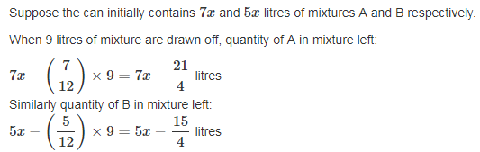
Explanation:

Slide 36
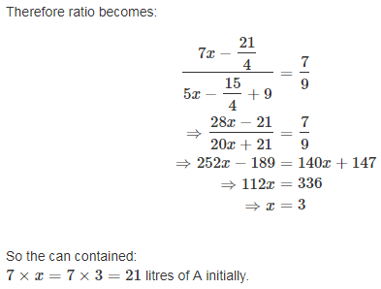
Explanation:

